Slide 1
sql project

Slide 2
agenda
Introduction
Codes

Slide 3
sql project
This sql project about gathering the information about the sales, revenue, orders per day, avg order from the data which cam be helpful for the business to take right decision which can further be helpful in growth of the company.
In further slides there will be query and syntax for that query

Slide 4
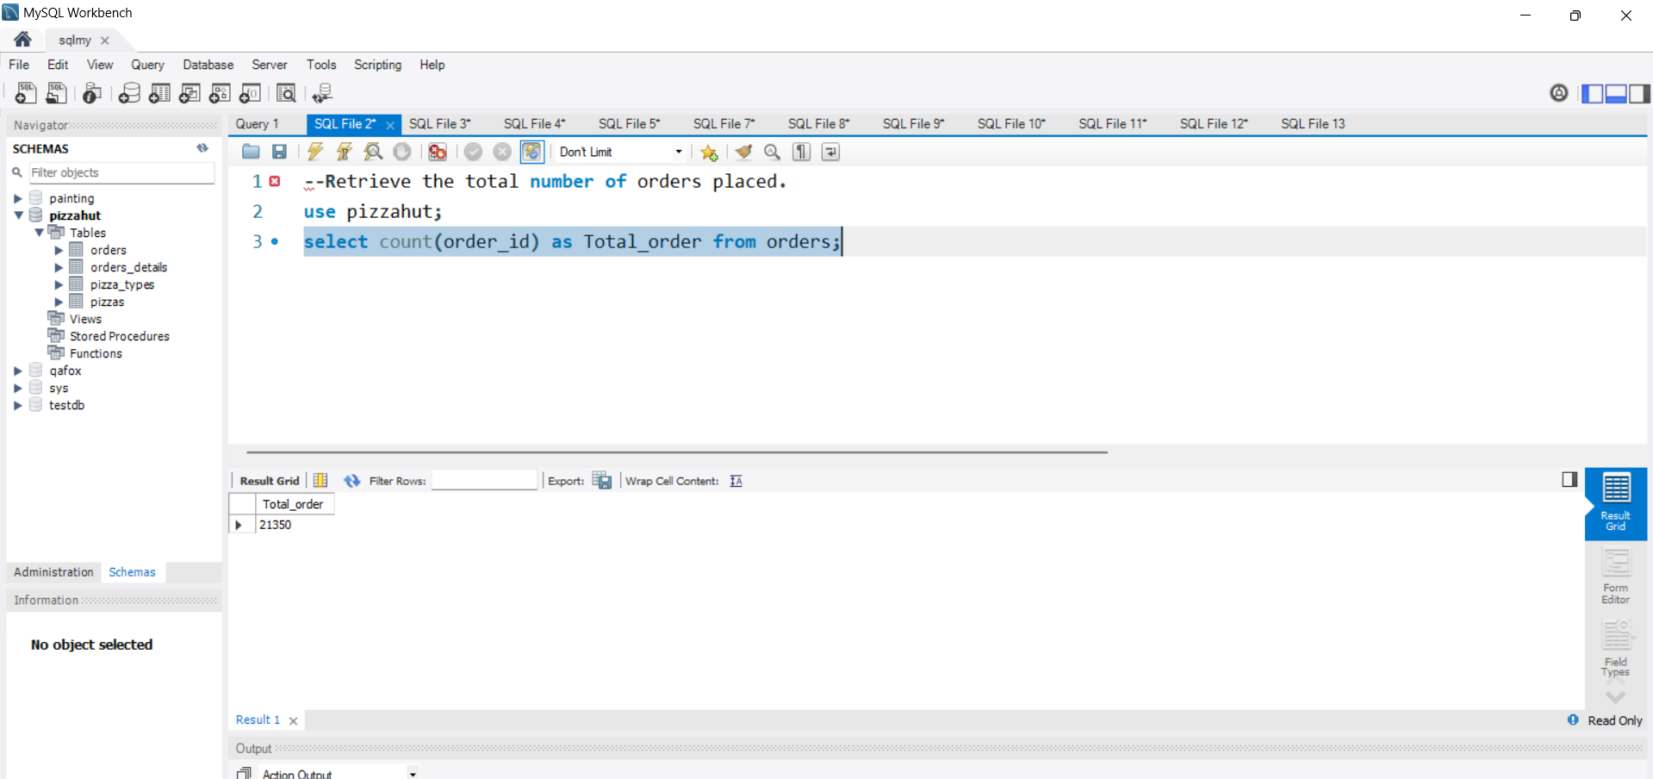

Slide 5
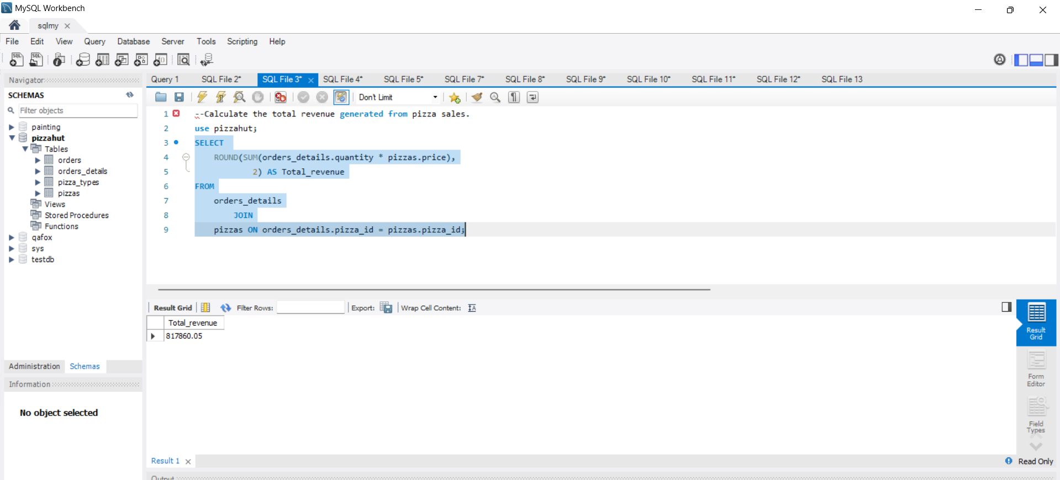

Slide 6
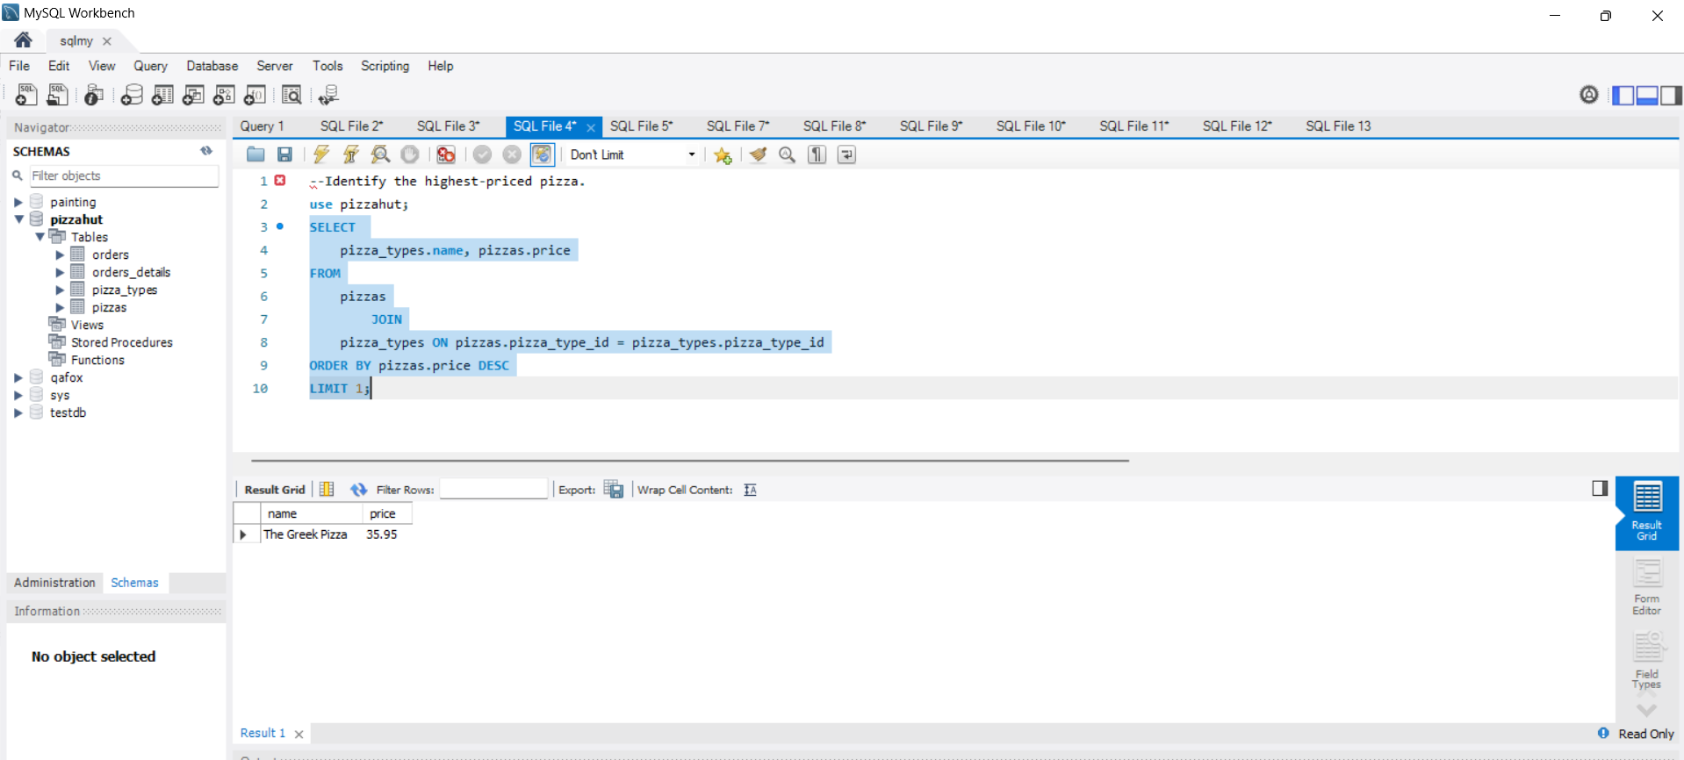

Slide 7
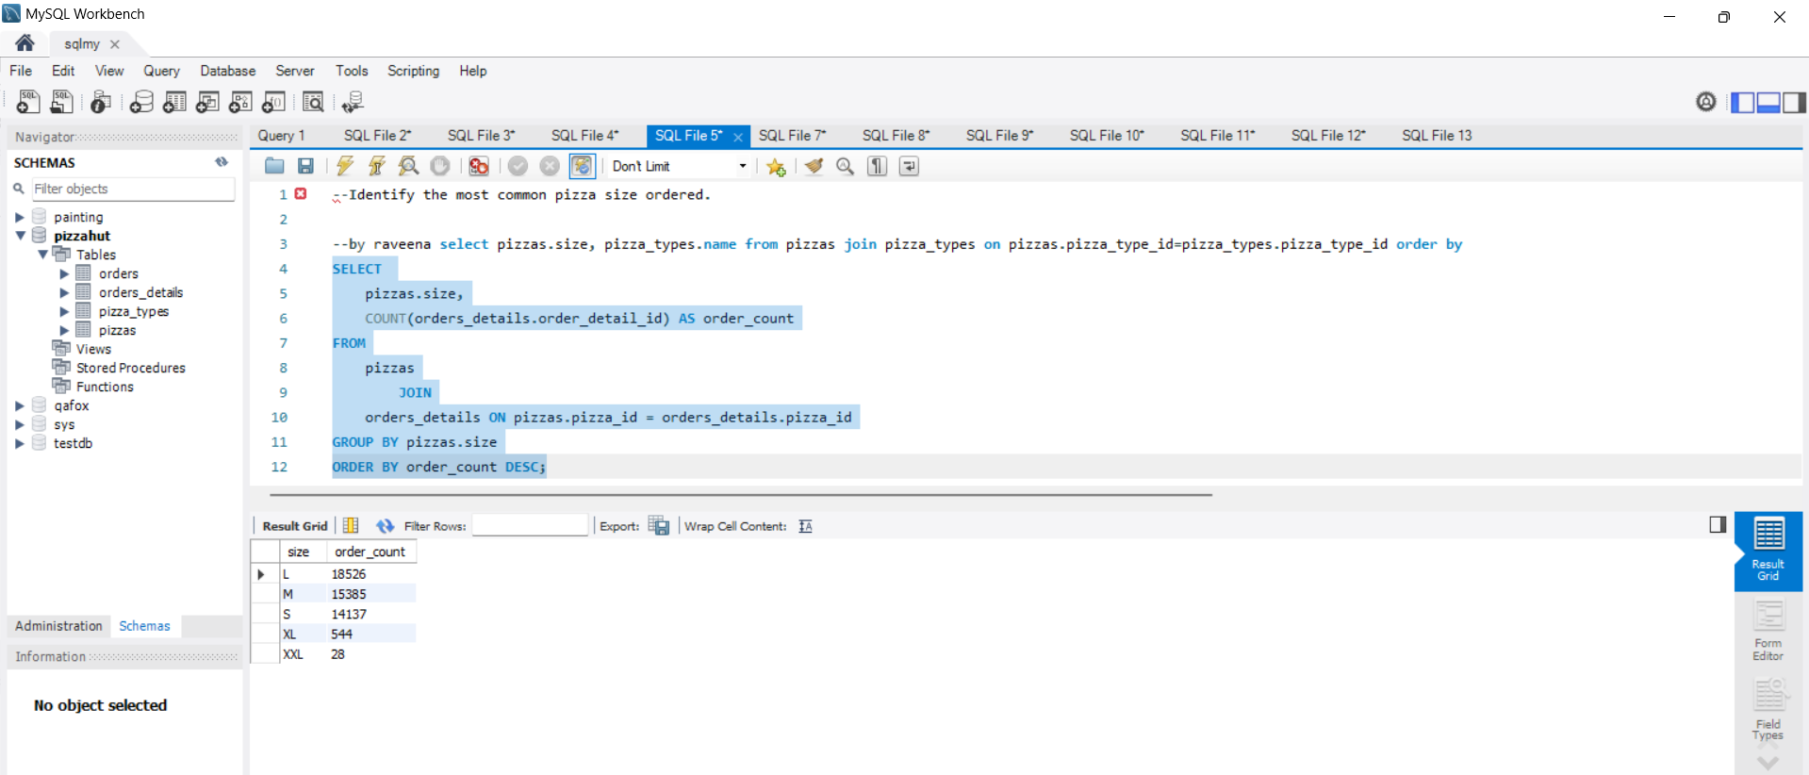

Slide 8
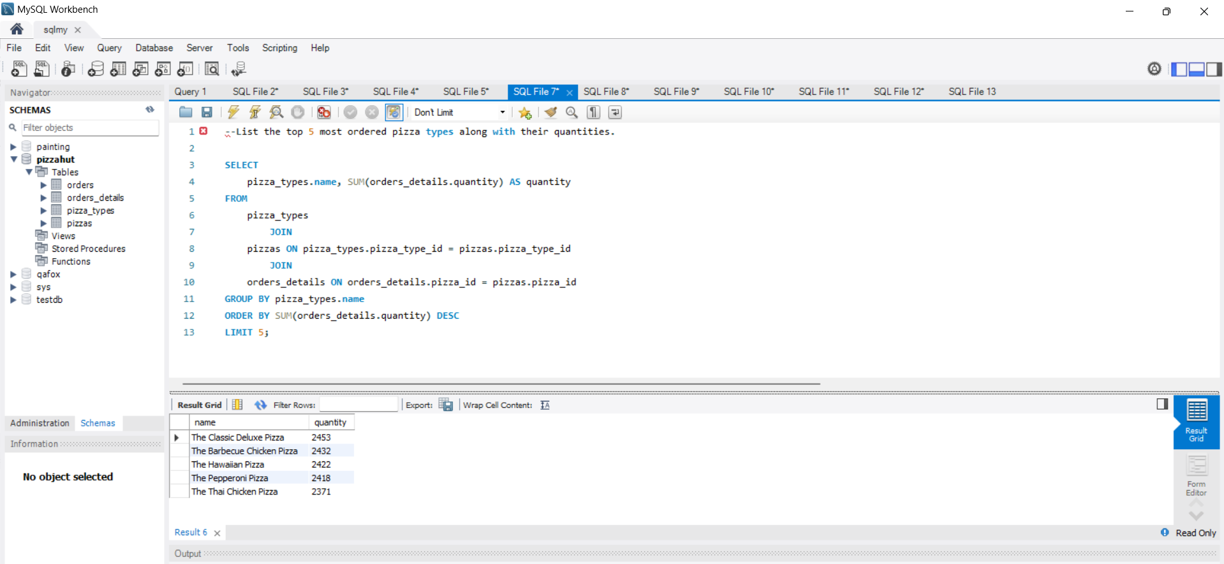

Slide 9
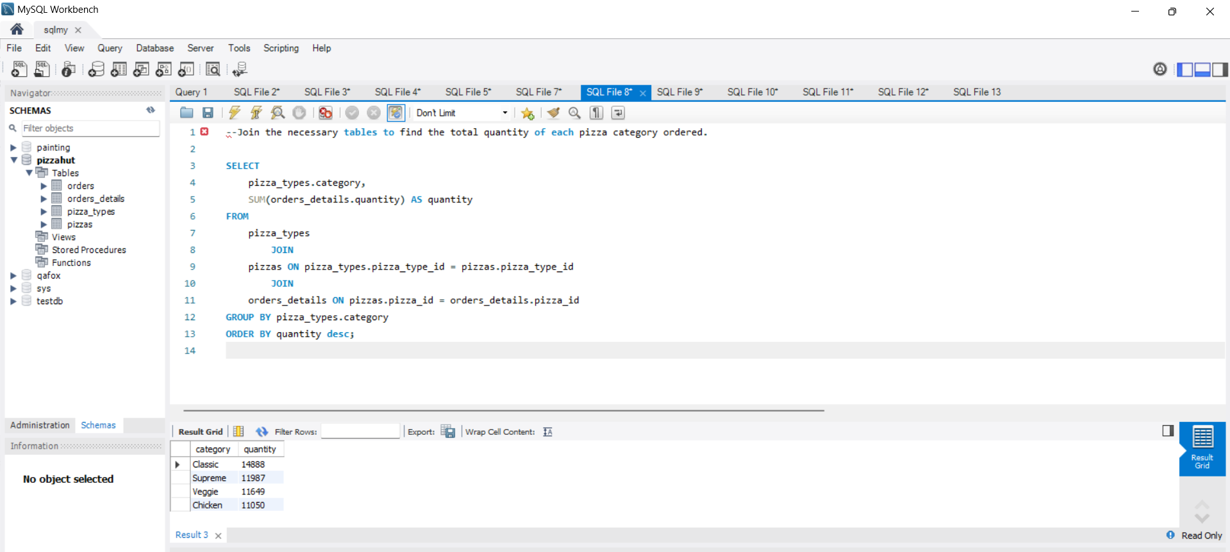

Slide 10
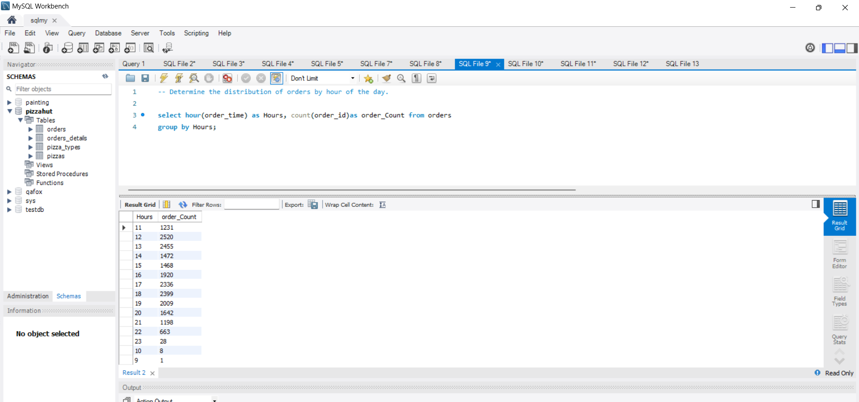

Slide 11
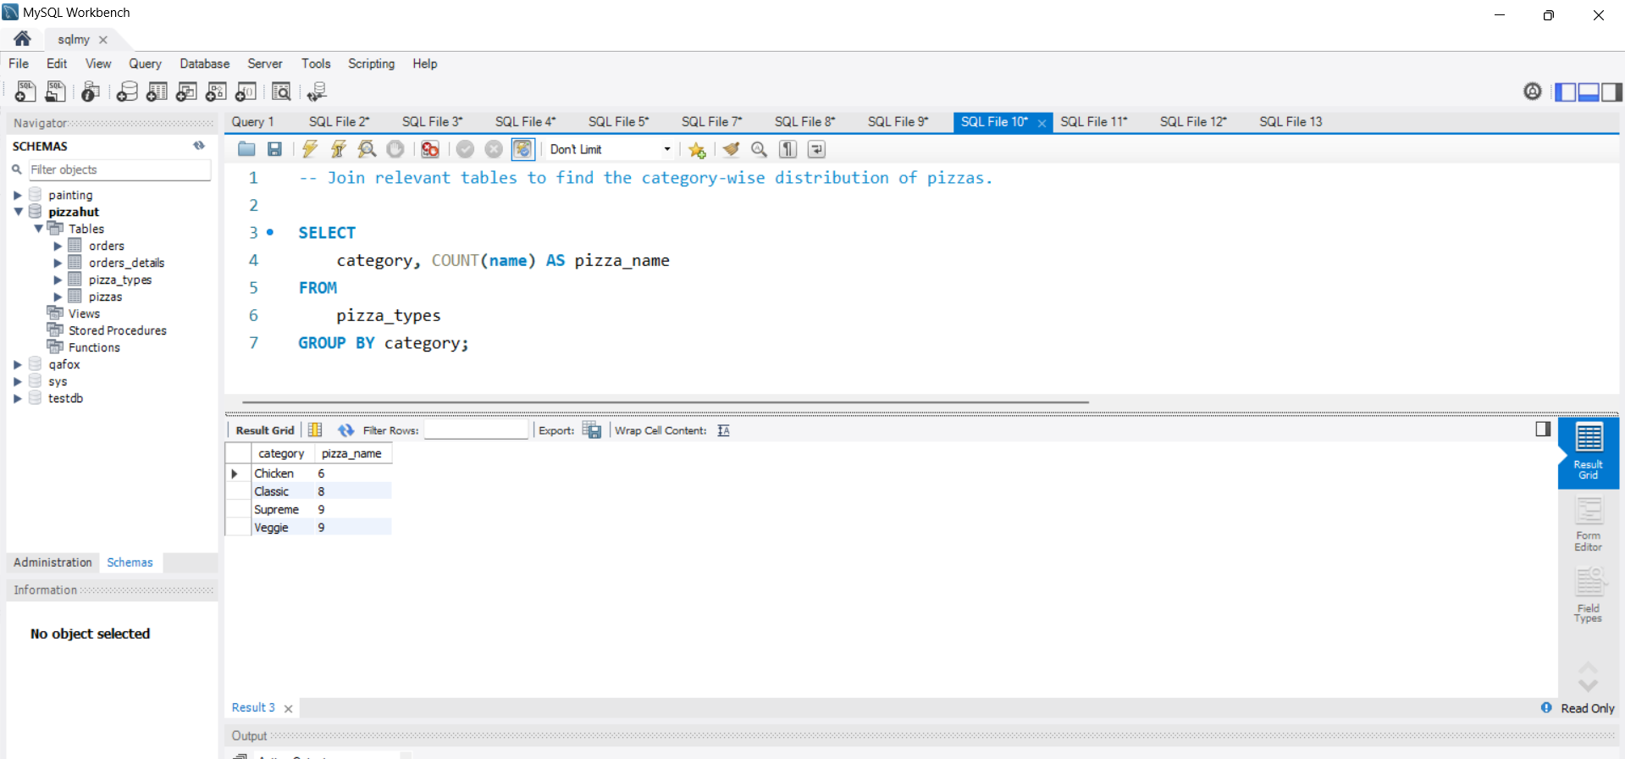

Slide 12
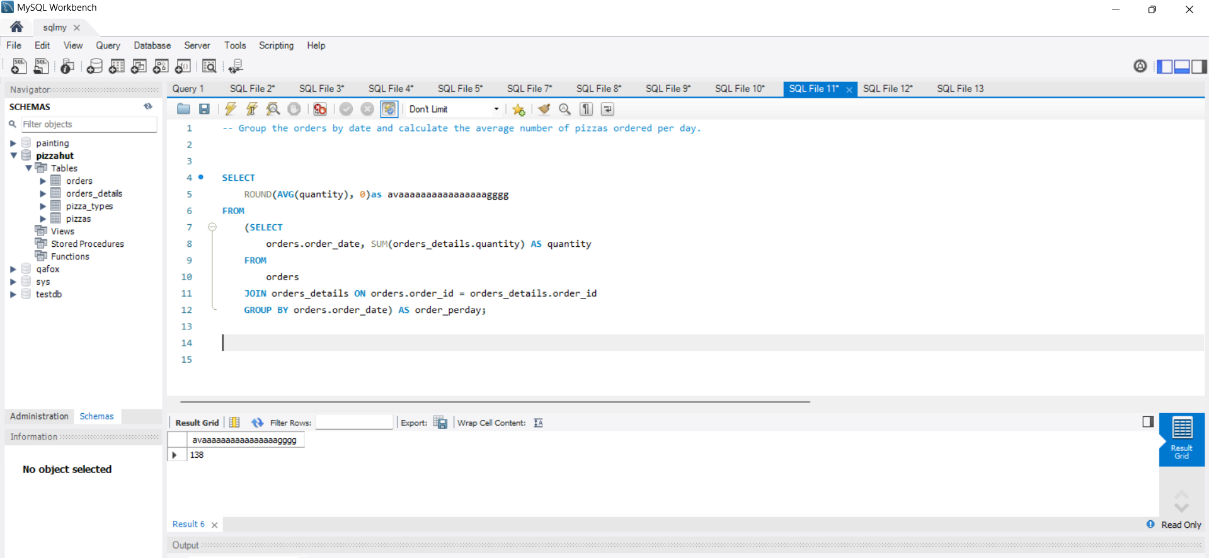

Slide 13
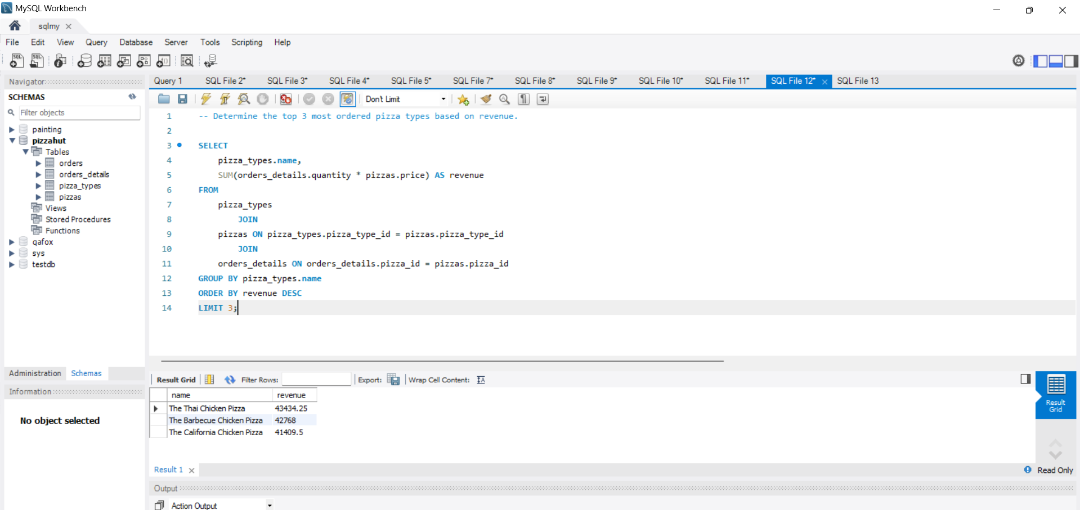

Slide 14
Thank you

